Slide 1


NTRODUCTION
About project :
A comprehensive analysis of stock performance over time
Can Use Image

Slide 2


OBJECTIVES
The goal of this project is to analyze historical stock price data using POWER BI to extract meaningful insights about stock performance, trends, and volatility.

Slide 3
PROJECT OVERVIEW
Project: Stock price analysis
Conducted By:Rajesh Kushwah
The goal of this project is to analyze historical stock price data using POWER BI to extract meaningful insights about stock performance, trends, and volatility
Data Source

Slide 4











TABLE OF CONTENT
1.Date
2.Open Price
3.High Price
4. Low Price
5. Close Price
6. Volume
7. Name

Slide 5
TOOLS
Like MS Power BI
Data Visualization & Dynamic Dashboard
Like MS Power Point
Presentation and Insights
Eg:MS Power Query
Data Cleaning and Preparation
Eg: Power Pivot
Data modelling & Relationships
Eg: DAX
Calculated Columns & Measures

Slide 6
DATA MANIPULATION PROCESS
Measures & Calculated Columns
Exclusions & Filters
Max value of stock)
Min value of stock
Mean values of stock
Median value of stock
Standard deviation
On-time Delivery Rate (OTDR)
Daily price change
Moving avg. 20 day
year
2013 data starts from July only. So, sales growth
calculated from July 2013 to April 2015.

Slide 7


INSIGHTS

Slide 8
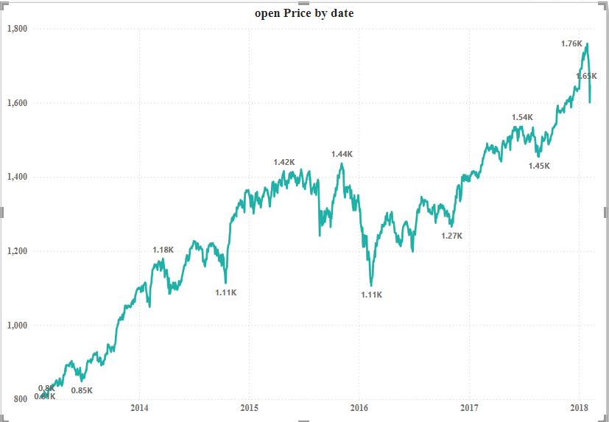
1.Visualize the stock price over time using line charts or time series visuals. This can help identify trends, seasonality, and any significant fluctuations.

Slide 9
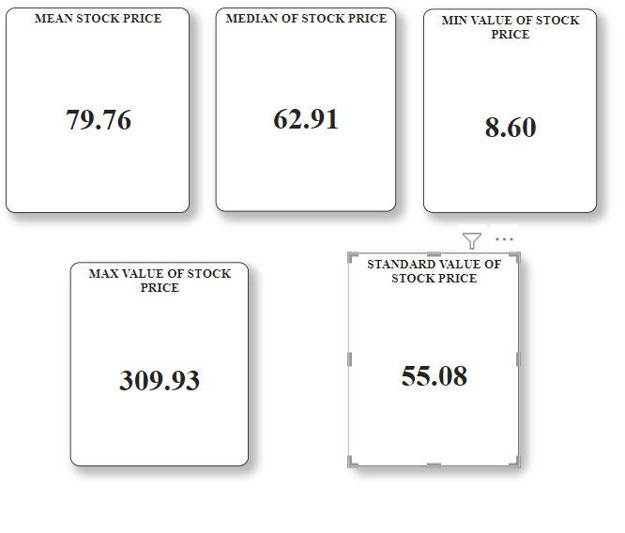
Calculate summary statistics like mean, median, minimum, maximum, and standard deviation of the stock prices. You can present this information in a table or use cards.

Slide 10
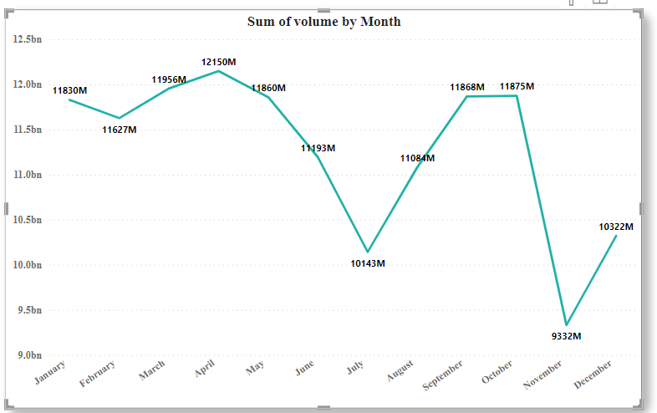
Analyze the trading volume over time to identify periods of high or low trading activity. This can provide insights into market sentiment and potential price movements.

Slide 11
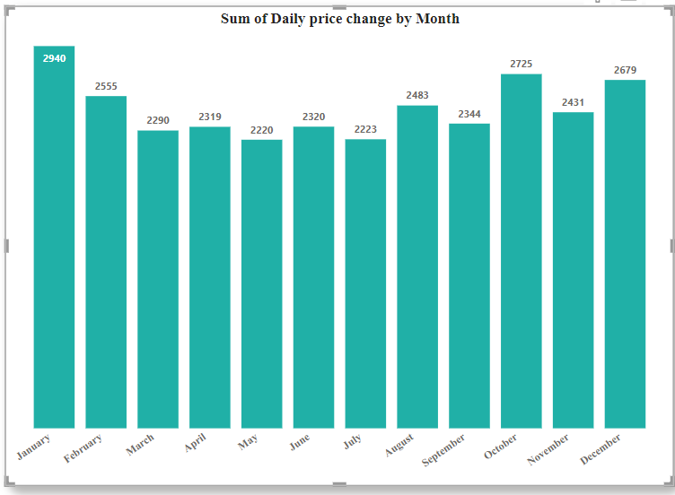
Calculate daily price changes and visualize them using Columns chart or line charts. This can help identify periods of high volatility.

Slide 12
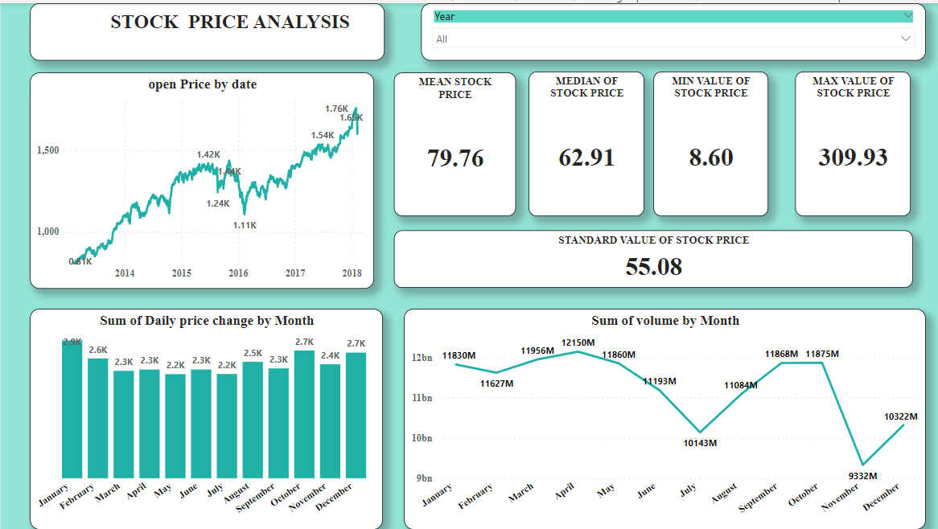

Slide 13

analysis
1.When the date are increase stock price may increase,
2.Mean of stock price 79.76.
3.Median of stock price 62.91
4.Maximum of stock price 309.93.
5.Minimum of stock price 8.60.
6.Standard deviation is 55.08.
7.Maximum volume reach at april month.
8.Minimum volume reach at November.
9.Maximum daily price change at January month I.e 2.9.
10.Minmum daily price change at may and july i.e 2.2K

Slide 14

THANK YOU

